Slide 1
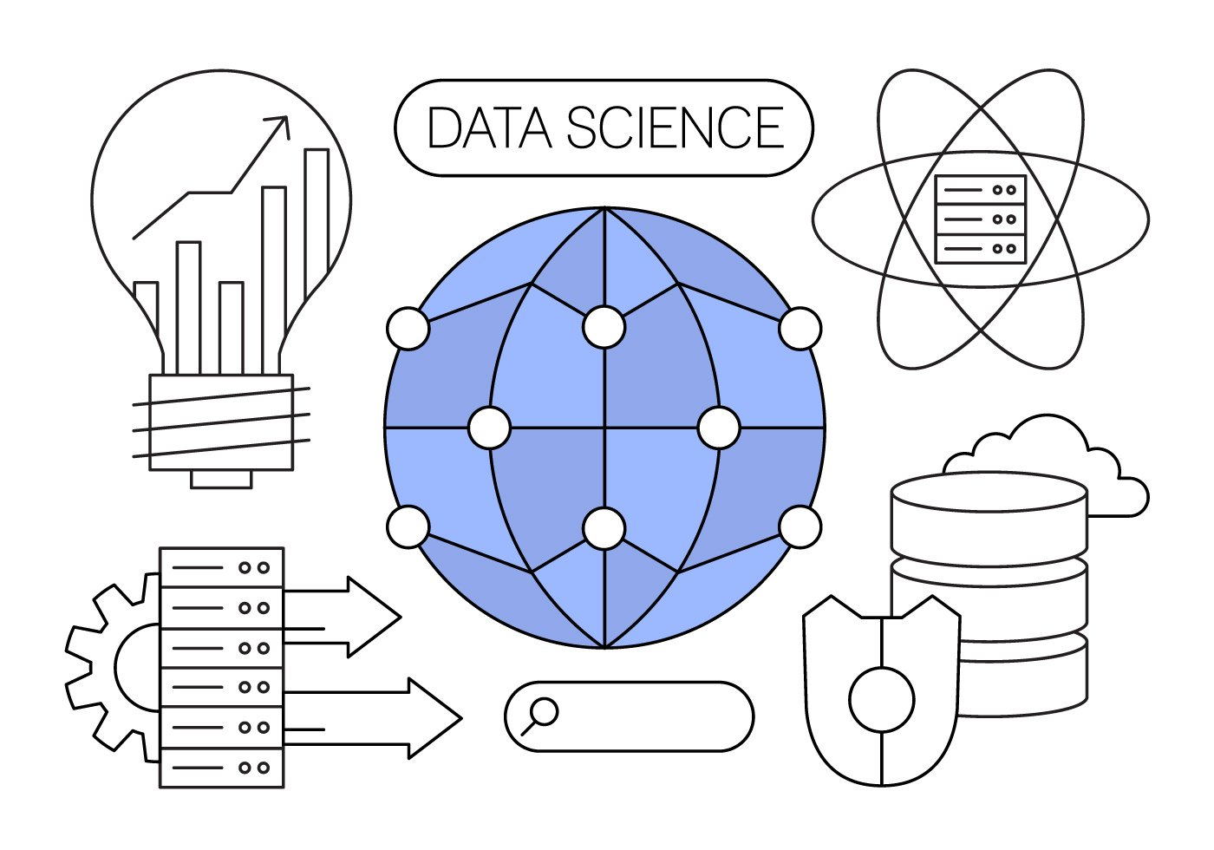
Introduction to Data Science

Slide 2

Speaker
Who Am I?
A second-year student at FAI KFSU
Core Team Member in Google DSC Kafr El-Sheikh University
You can find me through:
Email: ooshiba02@gmail.com
LinkedIn: linkedin.com/in/ooshiba
Omar Marouf

Slide 3
Agenda
What is data science?
What do we mean by data?
Why is data science important?
Types of data

Slide 4
What is data science?
In this topic we will talk about:
Definition of data science and its parts.
Data Analysis
Machine Learning

Slide 5

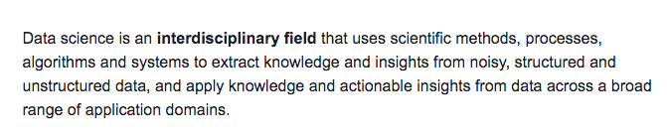
a.Definition of Data Science
Good, but what does that mean?

Slide 6
a.Definition of Data Science (In simple words)
Data Science is a field that is concerned with extracting information & knowledge from data.
How to achieve that?
- By combining multiple sciences together and use them all side by side to achieve that.
What are these sciences?
a. Statistics & Maths b. Computer Science c. Business
Ok, now I have a good overview. But what do you mean by data?
- Let’s know together ..

Slide 7
What is data?
In this topic we will talk about:
Definition of data
Data vs Information vs Knowledge

Slide 8

What is data?
Data is an abstract word. Alone, data has no meaning, but when stored together and organized, data give descriptive information.
Let’s imagine that data is just a piece of a puzzle
Data
=

Slide 9

What is data?
Data is an abstract word. Alone, data has no meaning, but when stored together and organized, data give descriptive information.
Now, let’s imagine we have collected a lot of pieces
Data
=

Slide 10

What is data?
Let’s collect data together and organize them

Slide 11
What is data?
Now we can conclude that data give us useful information when organized and collected together.

Slide 12
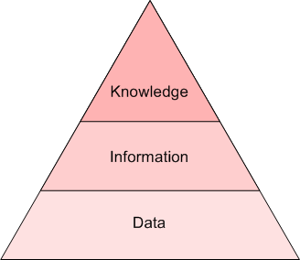
Data vs Information vs Knowledge

Slide 13
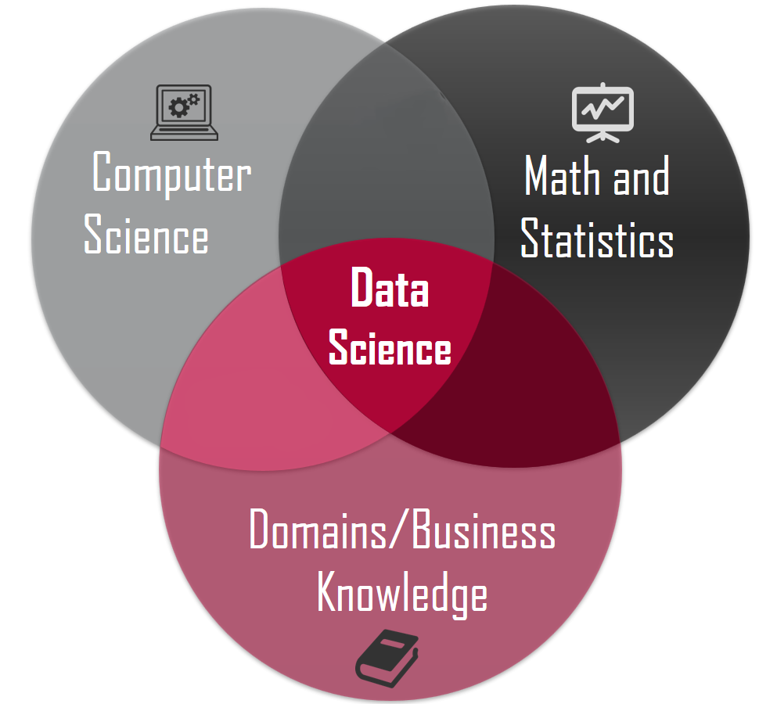
Now, let’s get back to data science
As we mentioned, data science is a combination of multiple sciences. Let’s see it better.

Slide 14
b.Parts of Data Science
Data Science
Data Analysis
Machine Learning

Slide 15

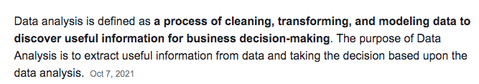
Data Analysis

Slide 16
Data Analysis
Now we can say that data analysis is used to clean given data, then applying some mathematical equations
to extract information from it.
Ex: Imagine a telecom company called PheleX. PheleX company discovered that suddenly, a big number of clients started converting to another company. They don’t know why big number of people do not use their services anymore. What is the solution?
They should give the data of users to a data analyst to answer this question
How will the data analyst answer this question?
- Let’s see ..

Slide 17

Data Analysis
First, the data analyst will collect the data required to be analyzed. Data Gathering

Slide 18
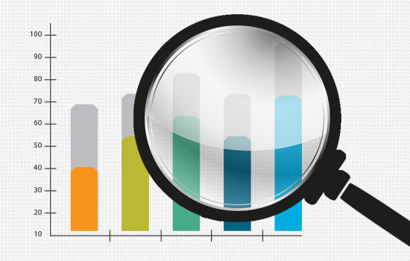
Data Analysis
Then, s/he will start looking through data and see an overview about it to discover
any problems in the data. Data Exploring

Slide 19

Data Analysis
After discovering the problems of the data, now these problems must be fixed. Data Cleaning
Problems like: Duplicates, Missing values (Nulls), bad structure of data .. etc

Slide 20
Data Analysis
Now, data is ready to be processed and get information from it.
We start analyzing data by applying some statistics on it to get useful information about each customer. Now we can know the average each customer pay monthly, where the customer lives, what is the annual profit the company gets from him/her … etc
With these information, we now can know what are the characteristics of a customer who would convert to another company, as well as the characteristics of a customer who would stay with the company.

Slide 21
Data Analysis
Example: We discovered that most people that converted to another company live in upper Egypt. Now let’s think why people living in upper Egypt are not happy with the service that they left us.
Maybe because the coverage in this area is not as good as in other cities?
Or maybe because they do not know about the services our company provides?
.
.
etc

Slide 22
Data Analysis
This is exactly how data analysis helps us to know things that we do not know, or to answer a question that we do not know the answer of.
Summary:
Data analysis helps us to extract information from data.
Data analysis allows us to answer questions we don’t know the answer of
Process of data analysis:
- Data Gathering
- Data Exploring
- Data Cleaning
- Data Analyzing

Slide 23

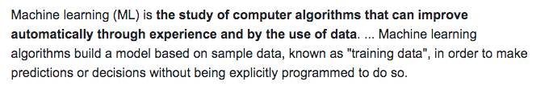
Machine Learning
The second component in data science is machine learning, let’s know more about it.

Slide 24
Machine Learning (In simple words)
Machine learning is a science that helps us predict future events from past events.
To be more precised, we say that machine learning predicts new data using old (historical) data.
How?
Through one or more algorithms.
An Algorithm is a sequence of steps that we use to achieve a certain goal
(In this case, to predict future events from past events that already happened)

Slide 25
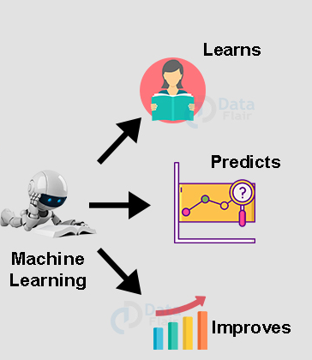
Machine Learning (In simple words)
Machine learning is just like a human. A machine learns from past data, predicts new data, and then improve itself day after day.

Slide 26
Machine Learning Algorithms
Following, some of the most famous algorithms used in Machine Learning (More specifically for data science):
Naïve Bayes
Linear Regression
Logistic Regression
KNN Algorithm

Slide 27
Why is data science important?
In this topic we will talk about:
Data science in Business
Data science in Healthcare
Data science in Sports

Slide 28

Data Science in Business
Predict Future Market Trends.
Gain Customer Insights.
Targeted Advertising

Slide 29

Data Science in Healthcare
Data Science helps in the recognition of scanned images to figure out the defects in a human body for helping doctors make an effective treatment strategy. These medical image tests include X-ray, sonography, MRI (Magnetic Resonance Imaging), CT scan, and many more.
Data Science helps a lot in predicting what cells could be cancerous one day, to keep track of them and decrease the potential of having cancer, as well as other diseases.

Slide 30

Data Science in Sports
Data science can be used in sports to determine which players should the team sign, what is the technique of the team, and how can they improve from themselves. Everything that a player does on the field can be measured these days. Data is a key part of recruiting players but data has to be applied correctly to build a team identity.
For example: Liverpool used data science to sign Mohamed Salah in 2017. A group of data scientists worked together to figure out who is the best player to join liverpool. They collected information about how the manager (Klopp) wanted the team to play, and based on this data, they decided that Mo Salah is the best option for liverpool.

Slide 31
Types of data
In this topic we will talk about:
Data types (according to the way it is stored)
Data types (according to the data itself)

Slide 32
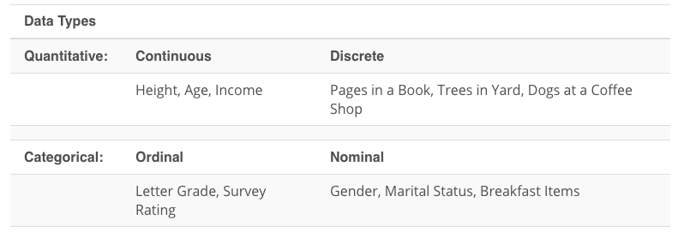
Types of data (acc to the way it is stored)
Structured
Unstructured

Slide 33
Types of data (acc to the way it is stored)
Structured data refers to data that resides in a fixed field within a file or record (Table).
Structured data is typically stored in a database. It can consist of numbers and text, and sourcing can happen automatically or manually, as long as it's within an database structure (Tables).
Examples: names – dates – addresses - credit card numbers

Slide 34
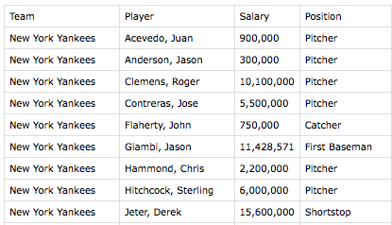
Types of data (acc to the way it is stored)
Form of the structured data:

Slide 35
Types of data (acc to the way it is stored)
Unstructured data refers to data that cannot be stored in a fixed form (table),data that is not arranged according to a pre-set data form.
Examples: images – emails– social media posts- videos - audios

Slide 36
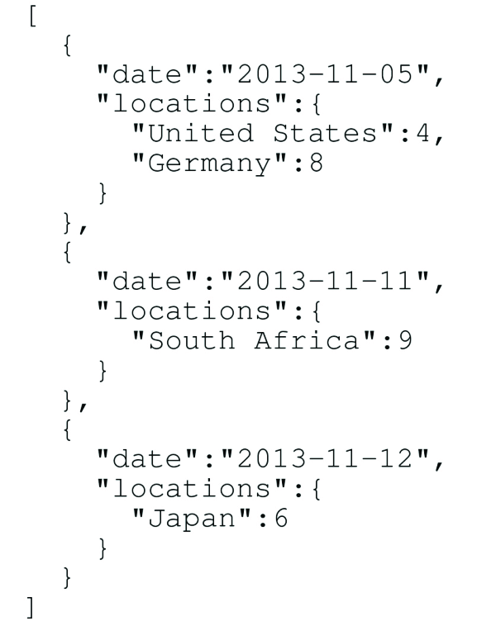
Types of data (acc to the way it is stored)
Form of the unstructured data:

Slide 38
Types of data (acc to the data itself)
Categorical (Qualitative)
Numerical (Quantitative)

Slide 39
Types of data (acc to the data itself)
Categorical data are measures of types and may be represented by a name, symbol, or a number code.
Examples of qualitative data:
Gender
Grade
Ratings
Martial Status

Slide 40
Types of data (acc to the data itself)
Numerical data are data about numeric variables. i.e. data that are represented by numbers and can do operations on them.
Examples of numerical data:
Pages of a book
Height
Age
Income

Slide 41

Thank you

